Slide 1
19CSE305: MACHINE LEARNING

Slide 2
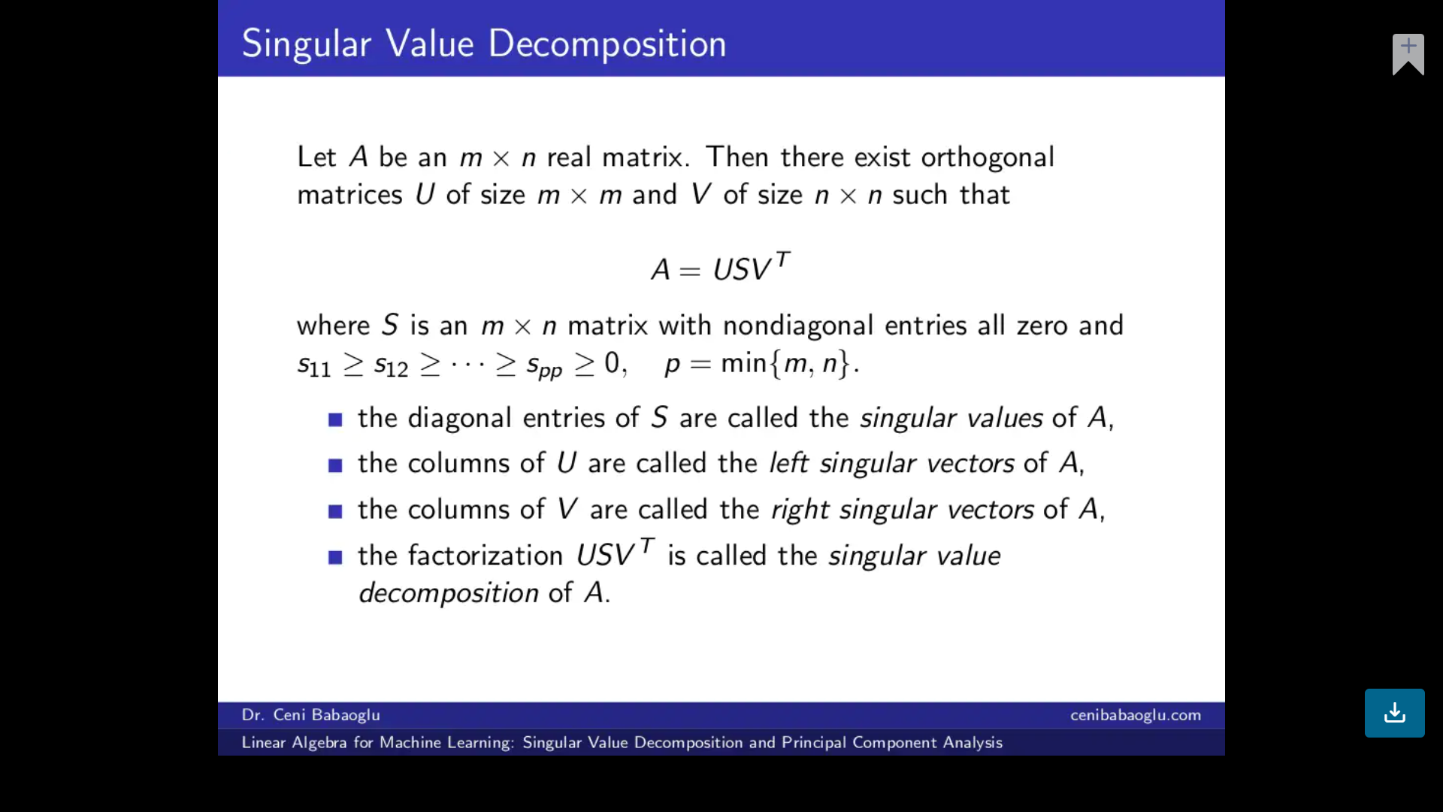
Singular Value Decomposition
SVD is basically a matrix factorization technique, which decomposes any matrix into 3 generic and familiar matrices..

Slide 3

Eigen Values and Eigen Vectors
The multiplication of a Matrix and a Vector produces another vector which is defined as the transformation occurred to that vector with respect to the specific matrix in the given vector space
There exist some vectors for some given Matrix such that their direction does not change even after the transformation is applied (similar to the vectors colored in blue in the above GIF). Such vectors are called the eigenvectors
The scaled valued of the vector after the transformation is defined as eigenvalue corresponding to that eigenvector
https://www.youtube.com/watch?v=PFDu9oVAE-g&list=PLZHQObOWTQDPD3MizzM2xVFitgF8hE_ab

Slide 4

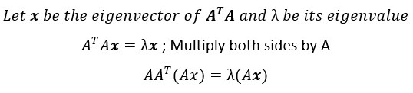
Singular Value Decomposition
Let A be any rectangular matrix of shape (m x n) . We can show that both AᵀA and AAᵀ are symmetric square matrices of shapes (n x n) and (m x m) respectively.
Both AᵀA and AAᵀ share the same non-zero eigenvalues.

Slide 5
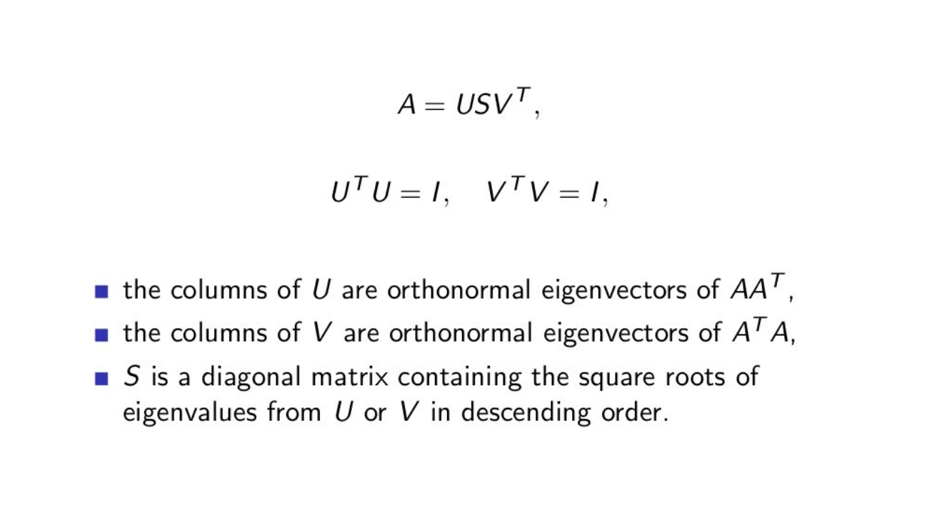
Singular Value Decomposition

Slide 6
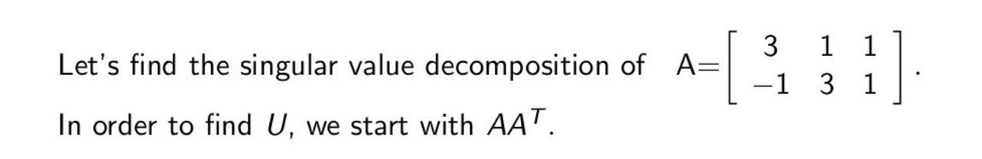
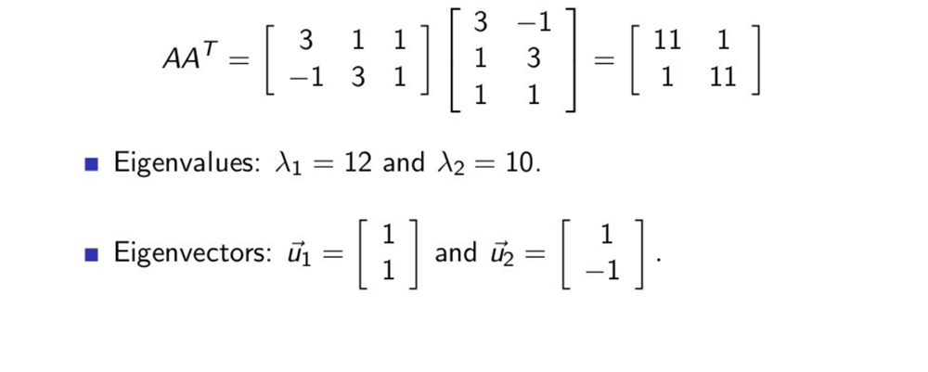
Singular Value Decomposition

Slide 7
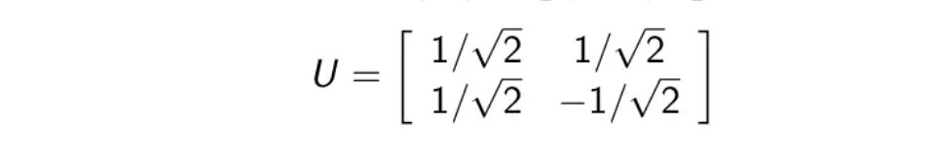
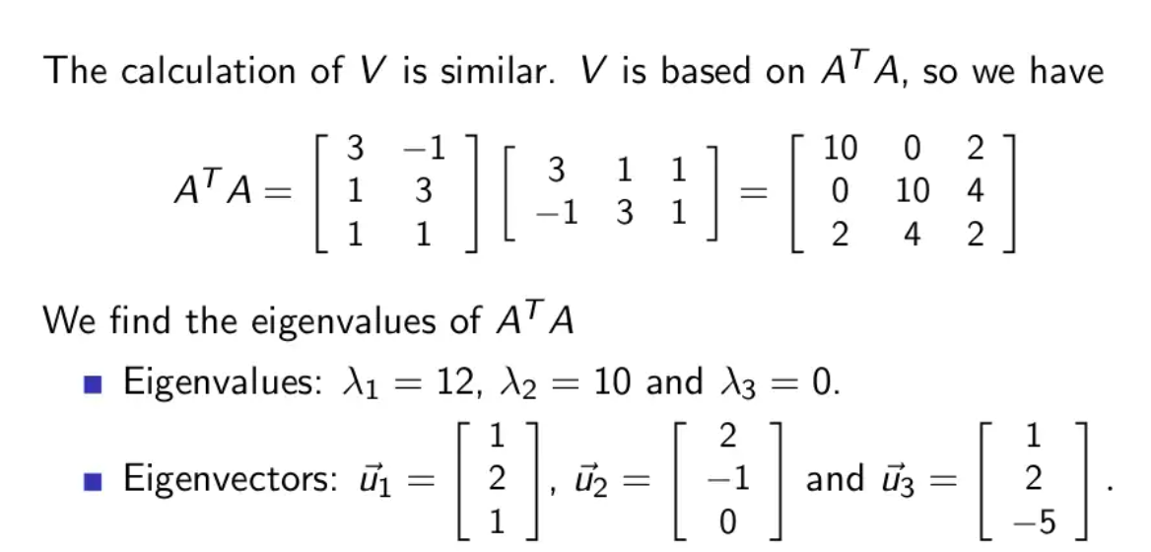
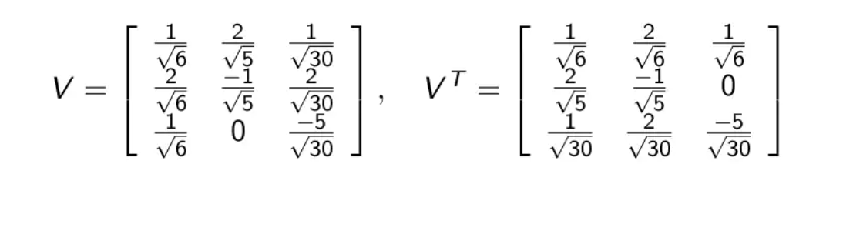
Singular Value Decomposition

Slide 8
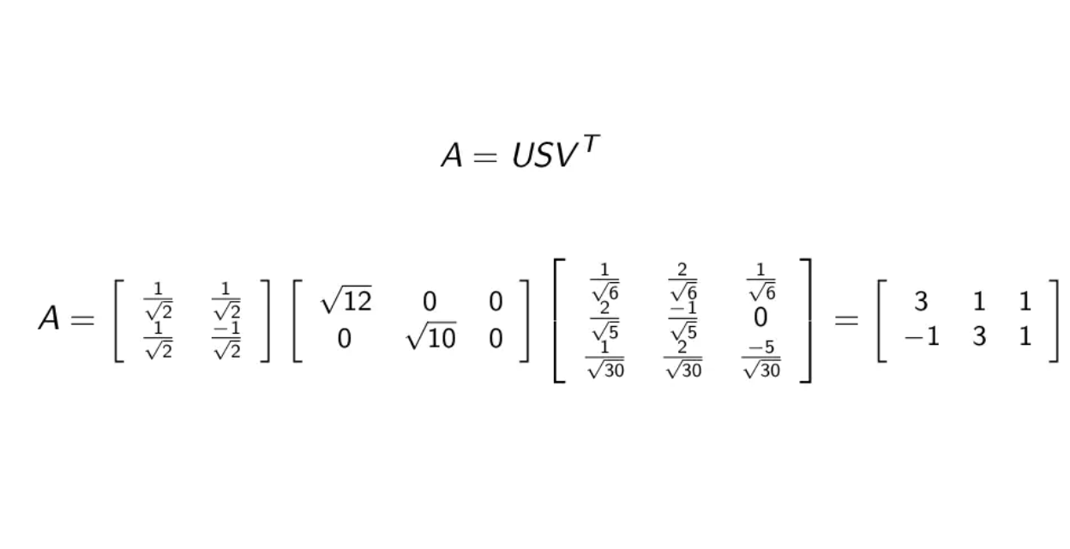
Singular Value Decomposition

Slide 9
THANK YOU

